Slide 1
TTT Stock Market League
Group 4 https://github.com/amalhotr/SMIL_project

Slide 2
What is TTT Stock Market League
The TTT Stock Market League allows users to compete with other users of varying experiences in a digital stock market. Users will be able to trade virtual currencies and stocks with an arbitrary budget while being able to track their progression.

Slide 3
Problems: Modern day Stock Market Trading can intimidate new investors from entering the Market because of complexity and lack of experience.
Solution: TTT Stock Market League will help with introducing new traders with an intuitive UI that promotes healthy trading habits, interactive tutorials, and educate the user on important concepts.
In addition, TTT Stock Market League will allow users to compete in a league to manage expectations and compare ability.

Slide 4
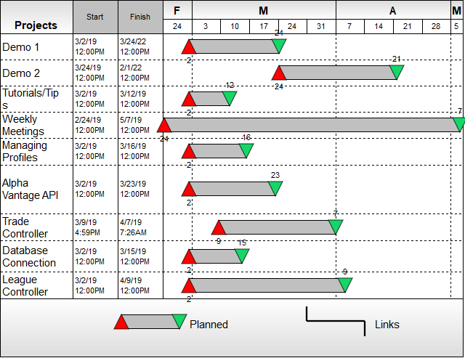

Slide 5
Future of TTT
Exporting Portfolio
Reinvest Dividends
News
Leaderboards
Education
Sector Recommendations
Trading Tutorials
Cryptocurrency
Front End Optimization

Slide 6
Use Cases
UC 1 - Registration
UC 2 - Login
UC 3 - Home
UC 4 - Dashboard
UC 5 - Lookup
UC 6 - Trade
UC 7 - Create Public League
UC 8 - Join Public League

